Slide 1
HWPL PEACE EDUCATION
Lesson 1
Democracy
Civics and Global Citizenship
Heavenly Culture, World Peace, Restoration of Light

Slide 2
HWPL PEACE EDUCATION
PART 01
What is Democracy?
Heavenly Culture, World Peace, Restoration of Light

Slide 3
HWPL PEACE EDUCATION
Heavenly Culture, World Peace, Restoration of Light
PART 01.
What is democracy?
Democracy comes from the Greek word democratia.
Democratia is a combination of the words demos, meaning “the people,” and kratos, meaning “domination.”
Democracy is a political system in which the people rule.

Slide 4
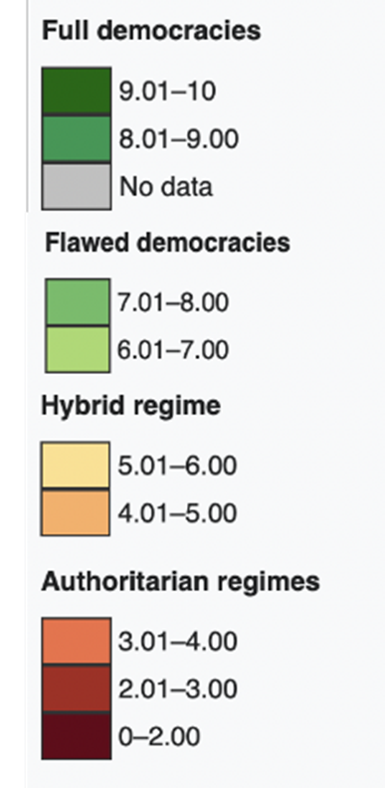
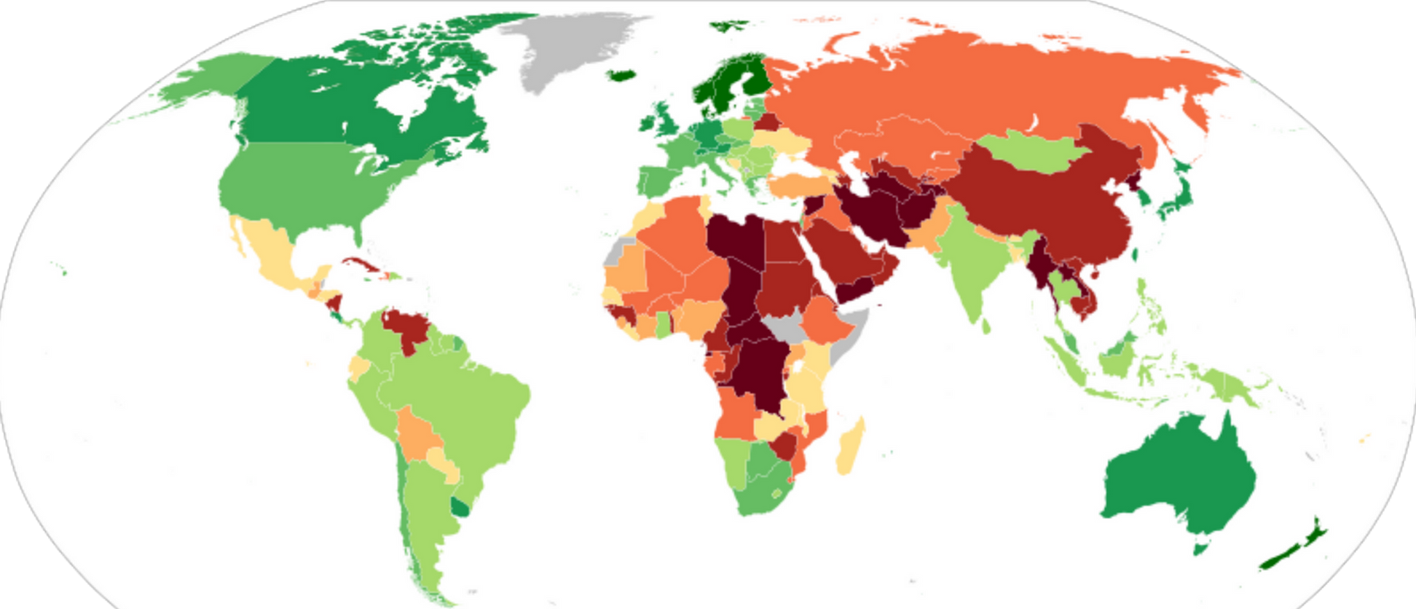
HWPL PEACE EDUCATION
Heavenly Culture, World Peace, Restoration of Light
PART 01.
What is democracy?

Slide 5
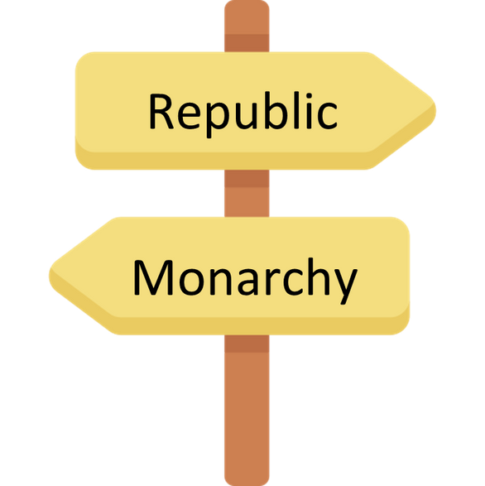
HWPL PEACE EDUCATION
Heavenly Culture, World Peace, Restoration of Light
PART 01.
What is democracy?
A word similar to democracy is republic.
A republican system, like democracy, is a political system in which sovereignty rests with the people.
The United Kingdom is actually a democratic country where the people rule, but formally it is not called a republic because there is a monarch.

Slide 6
HWPL PEACE EDUCATION
Heavenly Culture, World Peace, Restoration of Light
PART 01.
What is democracy?
Abraham Lincoln, the 16th president of the United States, defined democracy simply and clearly. He said democracy is “a government of the people, by the people, and for the people.”
First, “of the people” means that the power of the state comes from the people, and the people can form and control the government.
“By the people” means that national laws are made by the people and their representatives.
“For the people” means that the state should respect the will of the people and work for what the people want.

Slide 7
HWPL PEACE EDUCATION
PART 02
The Basic Spirits of Democracy
Heavenly Culture, World Peace, Restoration of Light

Slide 8
HWPL PEACE EDUCATION
Heavenly Culture, World Peace, Restoration of Light
PART 02.
The basic spirits of democracy
Human dignity
Freedom
Equality
Human dignity means that we must recognize the dignity that all human beings have from birth.
Negative freedom refers to not being subject to unnecessary interference and control from the state, and positive freedom refers to demanding one’s right from the state or participating in state affairs.
Equality means not being discriminated against based on race, gender, religion, etc.

Slide 9
HWPL PEACE EDUCATION
PART 03
Direct Democracy
and Representative Democracy
Heavenly Culture, World Peace, Restoration of Light

Slide 10
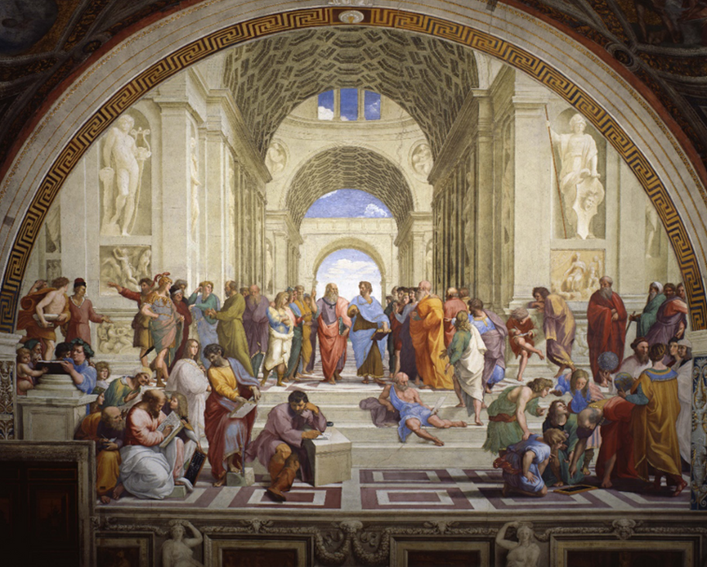
HWPL PEACE EDUCATION
Heavenly Culture, World Peace, Restoration of Light
PART 03.
Direct democracy and representative democracy
DemoDirect democracy refers to the direct participation of the people in national policymaking.
The School of Athens" by Raffaello Sanzio da Urbino

Slide 11
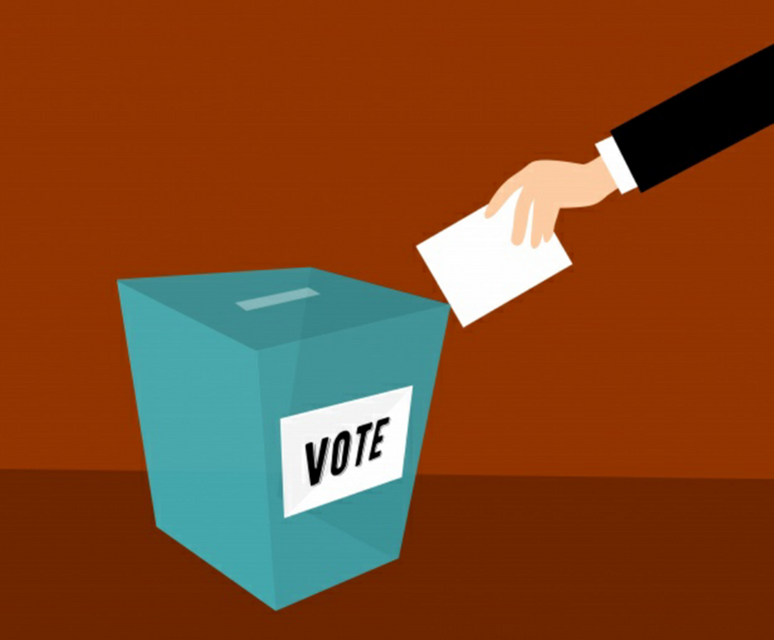
HWPL PEACE EDUCATION
Heavenly Culture, World Peace, Restoration of Light
PART 03.
Direct democracy and representative democracy
Representative democracy is a method in which representatives of the people are elected through elections, and national policies are discussed and handled through the elected representatives.

Slide 12
HWPL PEACE EDUCATION
Reviewing the Lesson
Heavenly Culture, World Peace, Restoration of Light

Slide 13
HWPL PEACE EDUCATION
Heavenly Culture, World Peace, Restoration of Light
Reviewing the Lesson
From what word does the word democracy come from, and what does it mean?

Slide 14
HWPL PEACE EDUCATION
Heavenly Culture, World Peace, Restoration of Light
Reviewing the Lesson
What did President Abraham Lincoln mean by “government of the people, by the people, and for the people”?

Slide 15
HWPL PEACE EDUCATION
Heavenly Culture, World Peace, Restoration of Light
Reviewing the Lesson
What are the basic spirits of democracy?

Slide 16
HWPL PEACE EDUCATION
Heavenly Culture, World Peace, Restoration of Light
Reviewing the Lesson
What is the difference between direct democracy and representative democracy?

Slide 17
HWPL PEACE EDUCATION
Activities
Heavenly Culture, World Peace, Restoration of Light

Slide 18
HWPL PEACE EDUCATION
Heavenly Culture, World Peace, Restoration of Light
Activities
Let’s have a family meeting and come up with an agenda for the family to decide together. Let’s discuss the agenda together and decide by voting.

Slide 19
HWPL PEACE EDUCATION
Heavenly Culture, World Peace, Restoration of Light
Activities
Create a group in your class to discuss the pros and cons of direct democracy and representative democracy.

Slide 20
HWPL PEACE EDUCATION
THANK
YOU:D
Heavenly Culture, World Peace, Restoration of Light

