Slide 1
HWPL PEACE EDUCATION
Lesson 2
History of the Development of Democracy 1
Civics and Global Citizenship
Heavenly Culture, World Peace, Restoration of Light

Slide 2
HWPL PEACE EDUCATION
PART 01
Direct Democracy
in Athens, Ancient Greece
Heavenly Culture, World Peace, Restoration of Light

Slide 3
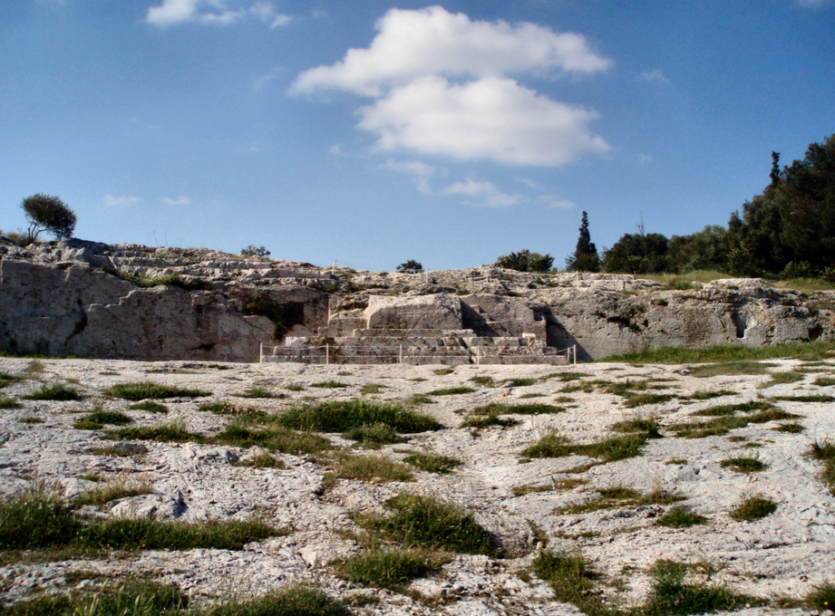
HWPL PEACE EDUCATION
Heavenly Culture, World Peace, Restoration of Light
PART 01.
Direct democracy in Athens, ancient Greece
Democracy first began in Athens, Greece. In Athens, an ancient city-state, besides the nobility, there was a class of citizens called Demos.
Pnyx Hill, where the assembly was held regularly

Slide 4
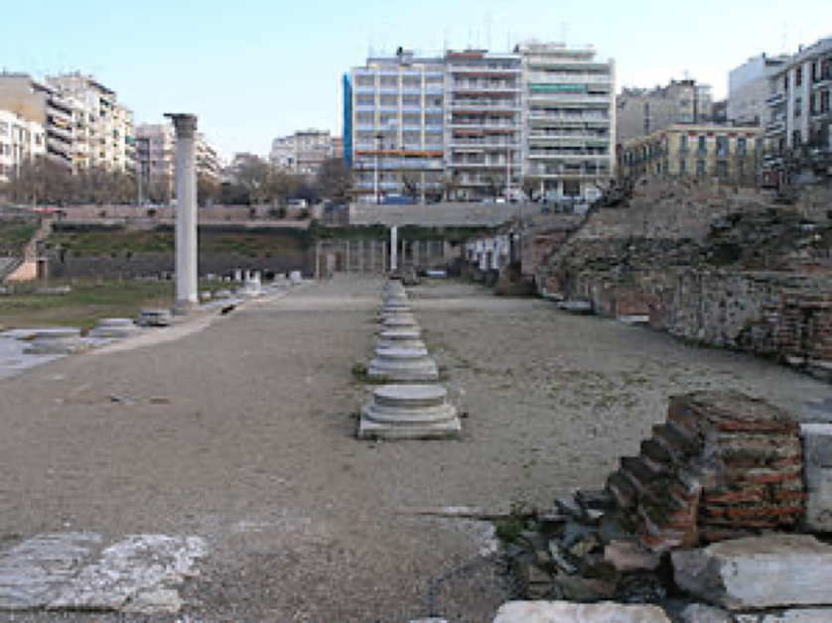
HWPL PEACE EDUCATION
Heavenly Culture, World Peace, Restoration of Light
PART 01.
Direct democracy in Athens, ancient Greece
A characteristic of Athenian democracy is that it was a direct democracy in which citizens directly participated in policy making.
Agora, a central public space in ancient Greek city-states

Slide 5
HWPL PEACE EDUCATION
Heavenly Culture, World Peace, Restoration of Light
PART 01.
Direct democracy in Athens, ancient Greece
BUT there were clearly limits.
Women did not have the right to vote. Slaves and foreigners who made up nearly half of the population were not recognized as citizens.

Slide 6
HWPL PEACE EDUCATION
PART 02
Magna Carta
Heavenly Culture, World Peace, Restoration of Light

Slide 7
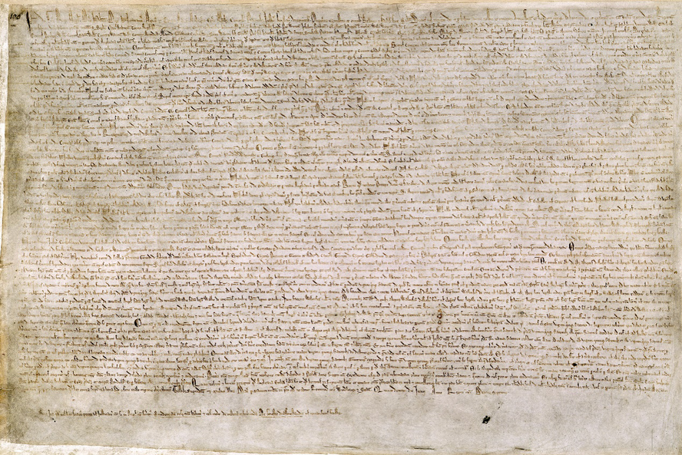
HWPL PEACE EDUCATION
Heavenly Culture, World Peace, Restoration of Light
PART 02.
Magna Carta
The Magna Carta, written in England in 1215, is the document that became the seed of democracy. The Magna Carta is a document that shows that the power of a king can be limited by law.
The Magna Carta (originally known
as the Charter of Liberties) of 1215

Slide 8
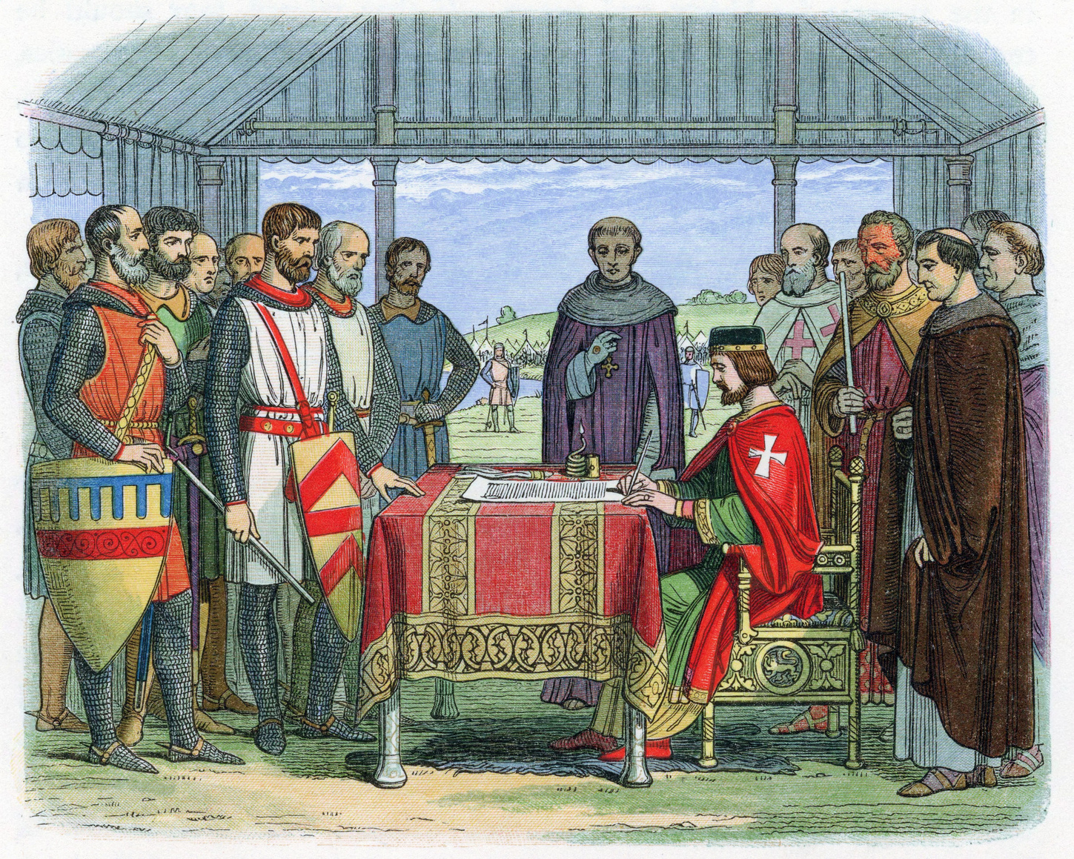
HWPL PEACE EDUCATION
Heavenly Culture, World Peace, Restoration of Light
PART 02.
Magna Carta
Article 12
“The king may not impose taxes without the approval of the nobles”
Article 39
“No arrest or detention other than in accordance with the law.”

Slide 9
HWPL PEACE EDUCATION
Heavenly Culture, World Peace, Restoration of Light
PART 02.
Magna Carta
It contains the will of nobles to run their own country according to laws and principles, rather than entrusting the fate of the country to the king. The Magna Carta was originally a document confirming the rights of the nobles, but over time it was used more and more as a basis of defending the rights of ordinary citizens.

Slide 10
HWPL PEACE EDUCATION
Reviewing the Lesson
Heavenly Culture, World Peace, Restoration of Light

Slide 11
HWPL PEACE EDUCATION
Heavenly Culture, World Peace, Restoration of Light
Reviewing the Lesson
What were the characteristics of Athenian democracy in Ancient Greece?

Slide 12
HWPL PEACE EDUCATION
Heavenly Culture, World Peace, Restoration of Light
Reviewing the Lesson
What were the limitation of Athenian democracy in Ancient Greece?

Slide 13
HWPL PEACE EDUCATION
Heavenly Culture, World Peace, Restoration of Light
Reviewing the Lesson
What do you call a country that has a monarch like the United Kingdom but is ruled by the constitution and the law?

Slide 14
HWPL PEACE EDUCATION
Heavenly Culture, World Peace, Restoration of Light
Reviewing the Lesson
What is the name of the document signed by King John of England in 1215? Why do we need species diversity?

Slide 15
HWPL PEACE EDUCATION
Heavenly Culture, World Peace, Restoration of Light
Reviewing the Lesson
What were the two key articles of the Magna Carta?

Slide 16
HWPL PEACE EDUCATION
Activities
Heavenly Culture, World Peace, Restoration of Light

Slide 17
HWPL PEACE EDUCATION
Heavenly Culture, World Peace, Restoration of Light
Activities
Search the internet for photos or videos that show Athens, the birthplace of democracy. Let’s also find places such as the Acropolis, Agora, and pnyx Hill. Find what they were used for and share them with the class.

Slide 18
HWPL PEACE EDUCATION
Heavenly Culture, World Peace, Restoration of Light
Activities
Let’s research and present more data about King John of England and the Magna Carta on the Internet.

Slide 19
HWPL PEACE EDUCATION
THANK
YOU:D
Heavenly Culture, World Peace, Restoration of Light

