Slide 1
HWPL PEACE EDUCATION
Lesson 12
Freedom
Civics and Global Citizenship
Heavenly Culture, World Peace, Restoration of Light

Slide 2
HWPL PEACE EDUCATION
PART 01
What is
Freedom?
Heavenly Culture, World Peace, Restoration of Light

Slide 3
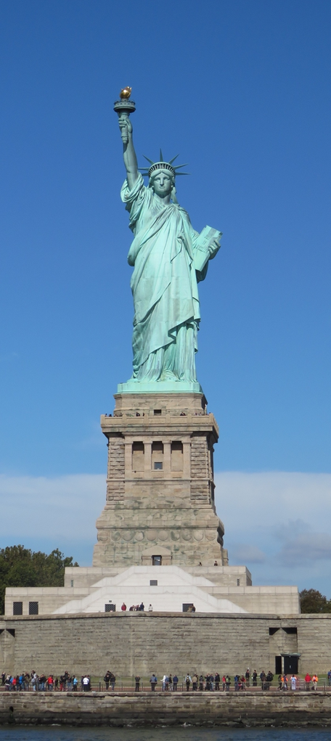
HWPL PEACE EDUCATION
Heavenly Culture, World Peace, Restoration of Light
PART 01.
What is freedom?
The dictionary definition of the word freedom is ‘the state of being able to do whatever you want without having restrains from an external force or being bound to anything.'
The standards for freedom of one individual should not be applied uniformly to everyone.
It is important to enjoy one’s freedom within the scope of harmonious coexistence among the members of society.
Statue of Liberty

Slide 4
HWPL PEACE EDUCATION
Heavenly Culture, World Peace, Restoration of Light
PART 02
What is the Relationship
Between Freedom and Equality?
Heavenly Culture, World Peace, Restoration of Light

Slide 5
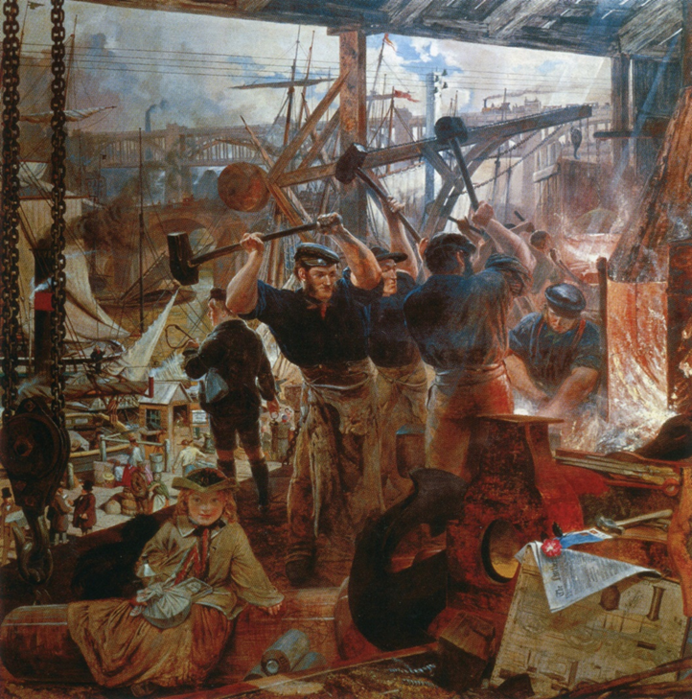
HWPL PEACE EDUCATION
Heavenly Culture, World Peace, Restoration of Light
PART 02.
What is the relationship between freedom and equality?
Freedom and equality are two important values that are the foundation of democracy. A society in which freedom and equality are in harmony is an ideal democratic society, but in reality, the two values often collide.
Workers during the British Industrial Revolution

Slide 6
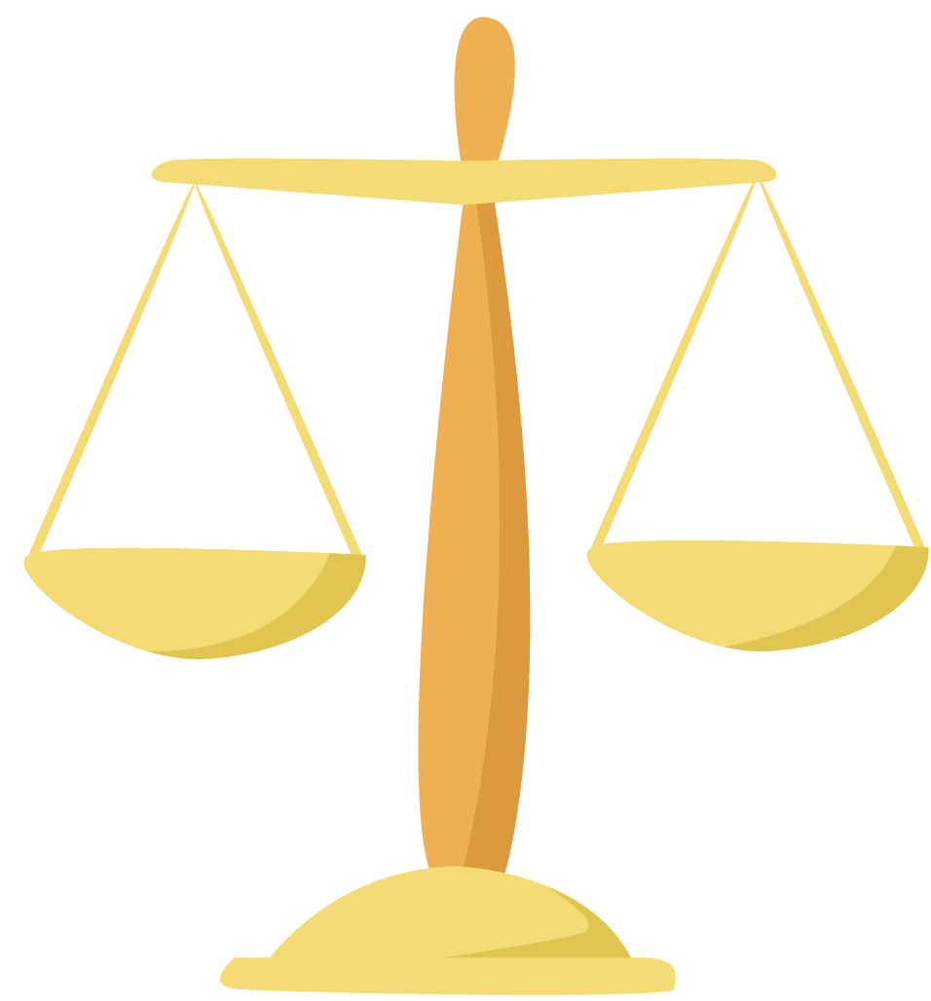
HWPL PEACE EDUCATION
Heavenly Culture, World Peace, Restoration of Light
PART 02.
What is the relationship between freedom and equality?
Freedom and equality are two important values that are the foundation of democracy. A society in which freedom and equality are in harmony is an ideal democratic society, but in reality, the two values often collide.

Slide 7
HWPL PEACE EDUCATION
Heavenly Culture, World Peace, Restoration of Light
PART 02.
What is the relationship between freedom and equality?
Although the values of freedom and equality are conflicting, it is impossible to say which one is more important. If one pursues only one value to the extreme, side effects occur like in the examples above.
Therefore, we must recognize that freedom and equality are values that complement each other’s flaws, and we must strive to maintain an appropriate balance between the two.

Slide 8
HWPL PEACE EDUCATION
PART 03
Types of Freedom
Heavenly Culture, World Peace, Restoration of Light

Slide 9
HWPL PEACE EDUCATION
Heavenly Culture, World Peace, Restoration of Light
PART 03.
Types of freedom
Physical freedom means freedom without physical restrictions except by law.
Freedom of expression refers to the freedom of individuals or groups to freely express their views and ideas.
Freedom of movement and residence refers to the freedom to live anywhere within a country, to move residency, or to travel freely.

Slide 10
HWPL PEACE EDUCATION
Heavenly Culture, World Peace, Restoration of Light
PART 03.
Types of freedom
Freedom of property refers to the freedom to own, use, profit from, and dispose of property.
Occupational freedom refers to the freedom to choose, engage in, and change occupations as one desires.
Freedom of religion means freedom to choose or not to choose a religion according to one’s will.

Slide 11
HWPL PEACE EDUCATION
Heavenly Culture, World Peace, Restoration of Light
Reviewing the Lesson
Heavenly Culture, World Peace, Restoration of Light

Slide 12
HWPL PEACE EDUCATION
Heavenly Culture, World Peace, Restoration of Light
Reviewing the Lesson
What is the dictionary definition of freedom?

Slide 13
HWPL PEACE EDUCATION
Heavenly Culture, World Peace, Restoration of Light
Reviewing the Lesson
What is the extent of the freedom that an individual can exercise?

Slide 14
HWPL PEACE EDUCATION
Heavenly Culture, World Peace, Restoration of Light
Reviewing the Lesson
What are some examples where the values of freedom and equality collide?

Slide 15
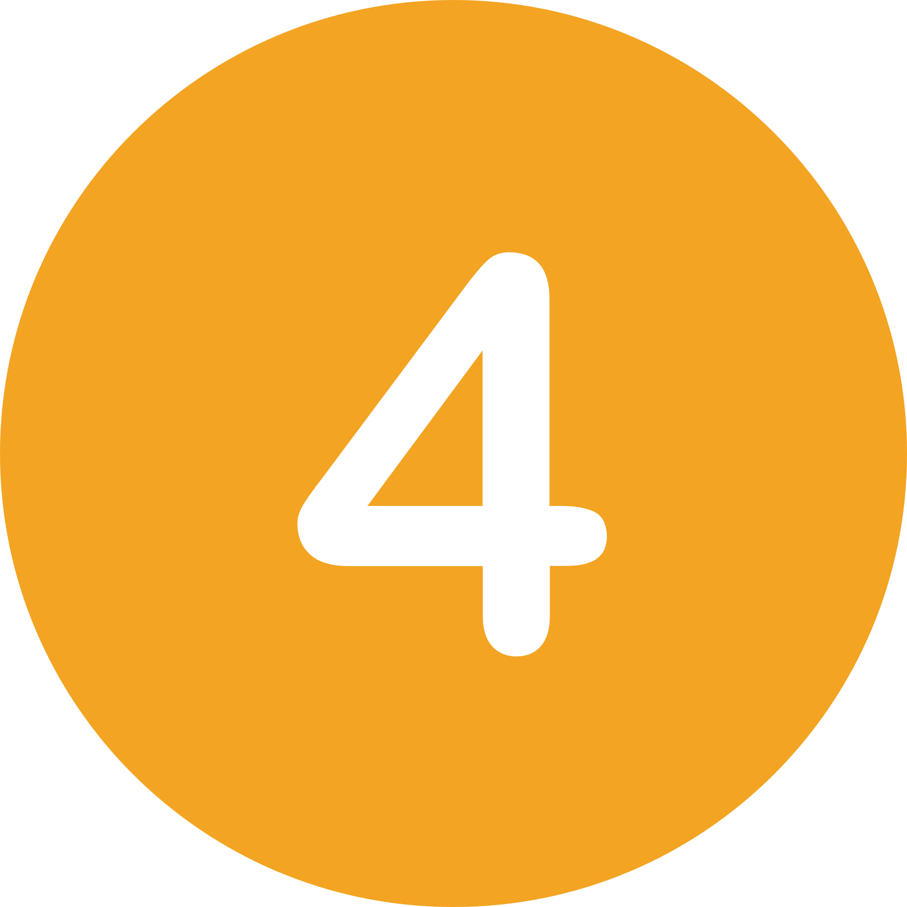
HWPL PEACE EDUCATION
Heavenly Culture, World Peace, Restoration of Light
Reviewing the Lesson
What are some types of freedom?

Slide 16
HWPL PEACE EDUCATION
Activities
Heavenly Culture, World Peace, Restoration of Light

Slide 17
HWPL PEACE EDUCATION
Heavenly Culture, World Peace, Restoration of Light
Activities
Let’s get into groups and discuss whether the different types of freedom guaranteed by the law are being well applied to each and everyone of us.

Slide 18
HWPL PEACE EDUCATION
Heavenly Culture, World Peace, Restoration of Light
Activities
Let’s think and present about whether there have been cases where my freedom has infringed on someone else’s freedom or, conversely, whether there have been cases where others have infringed my freedom.

Slide 19
HWPL PEACE EDUCATION
THANK
YOU:D
Heavenly Culture, World Peace, Restoration of Light

