Slide 1
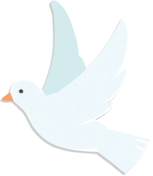
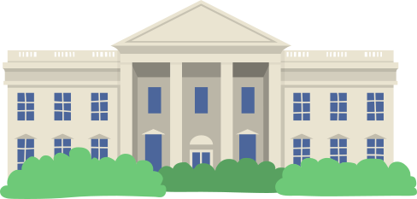
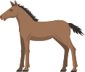

Slide 2
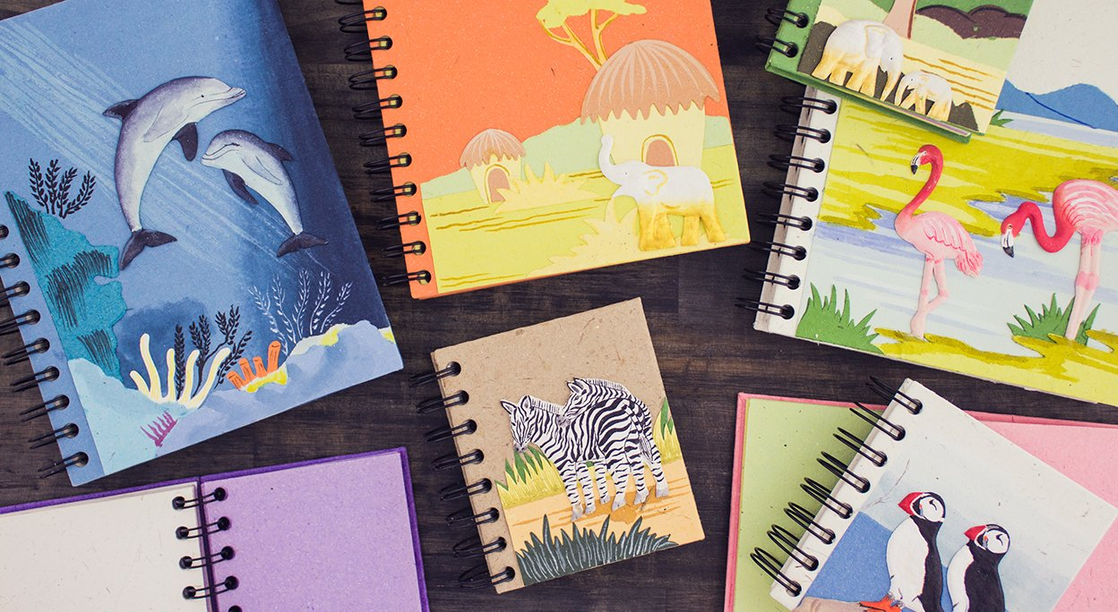
Opening Story
What is this paper made from?
Elephant’s dung

Slide 3
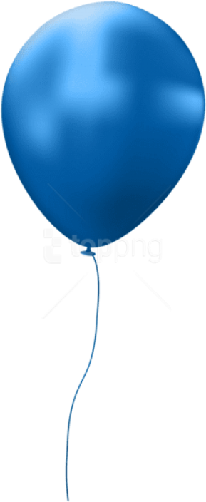
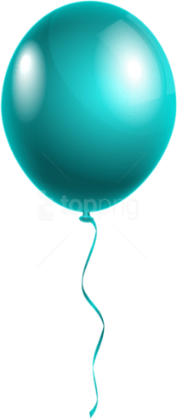
Exploration 1
My Value

Slide 4
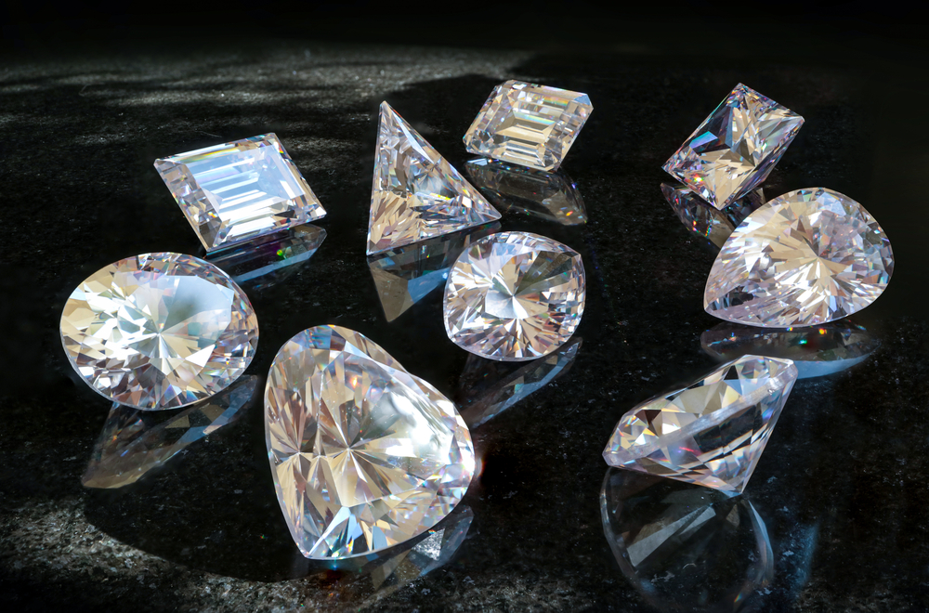
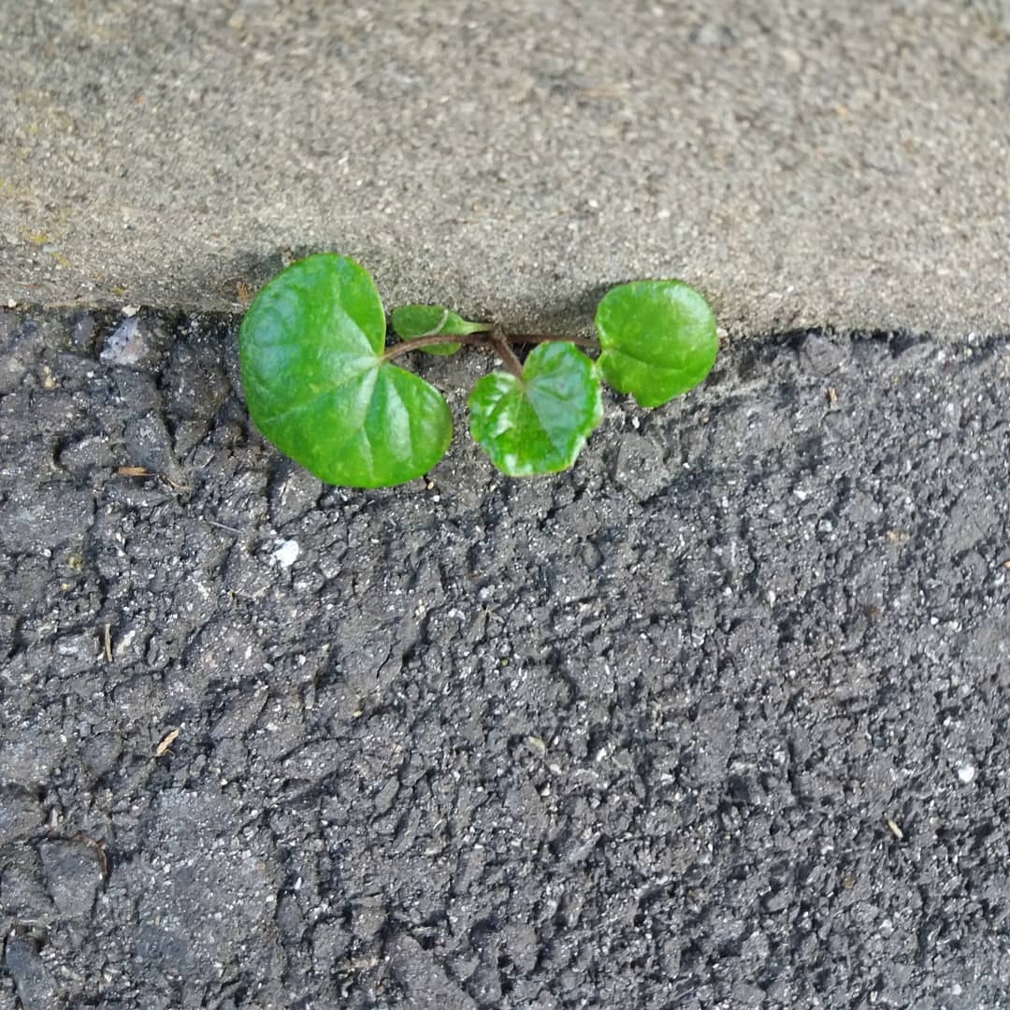
01
The value of life
A human cannot create even a single blade of grass or a flower commonly growing in a field
* Origin of the word “diamond” comes from the Greek “adamas” meaning “unconquerable, invincible

Slide 5
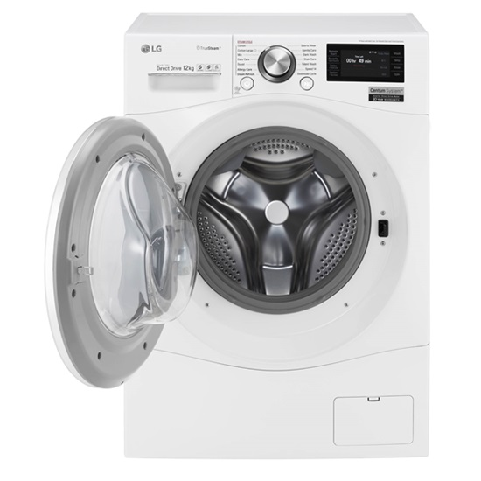
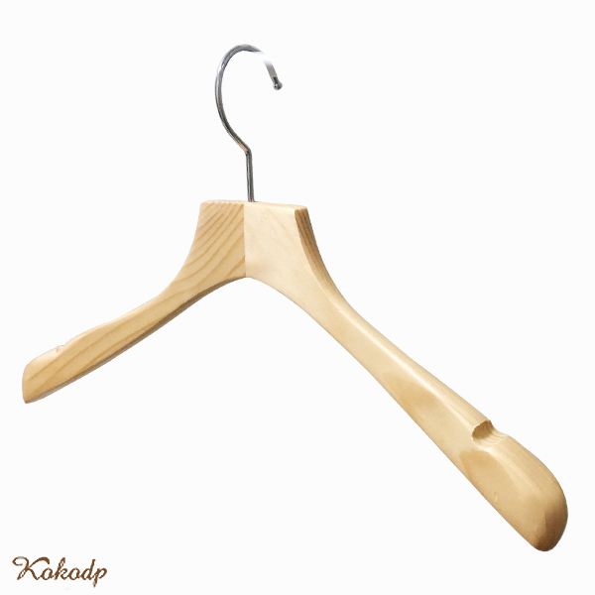
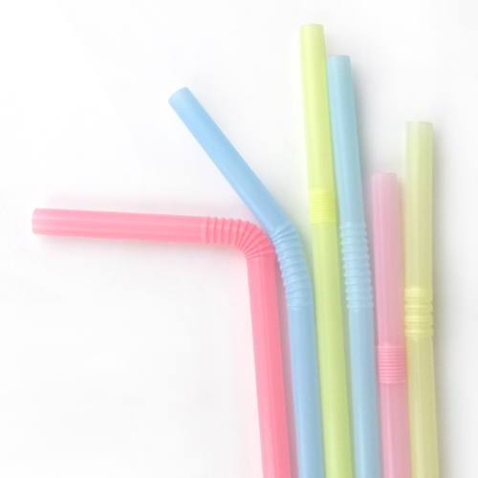
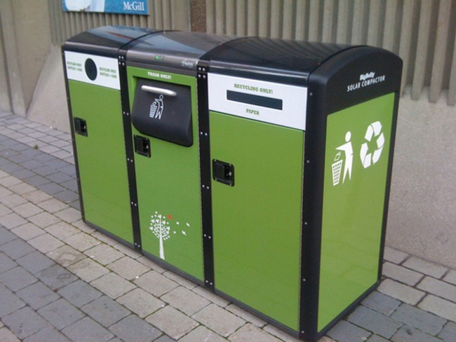
02
A name, expressing the value of existence
washing machine
hanger
straw
trash can
Teacher
Student

Slide 6
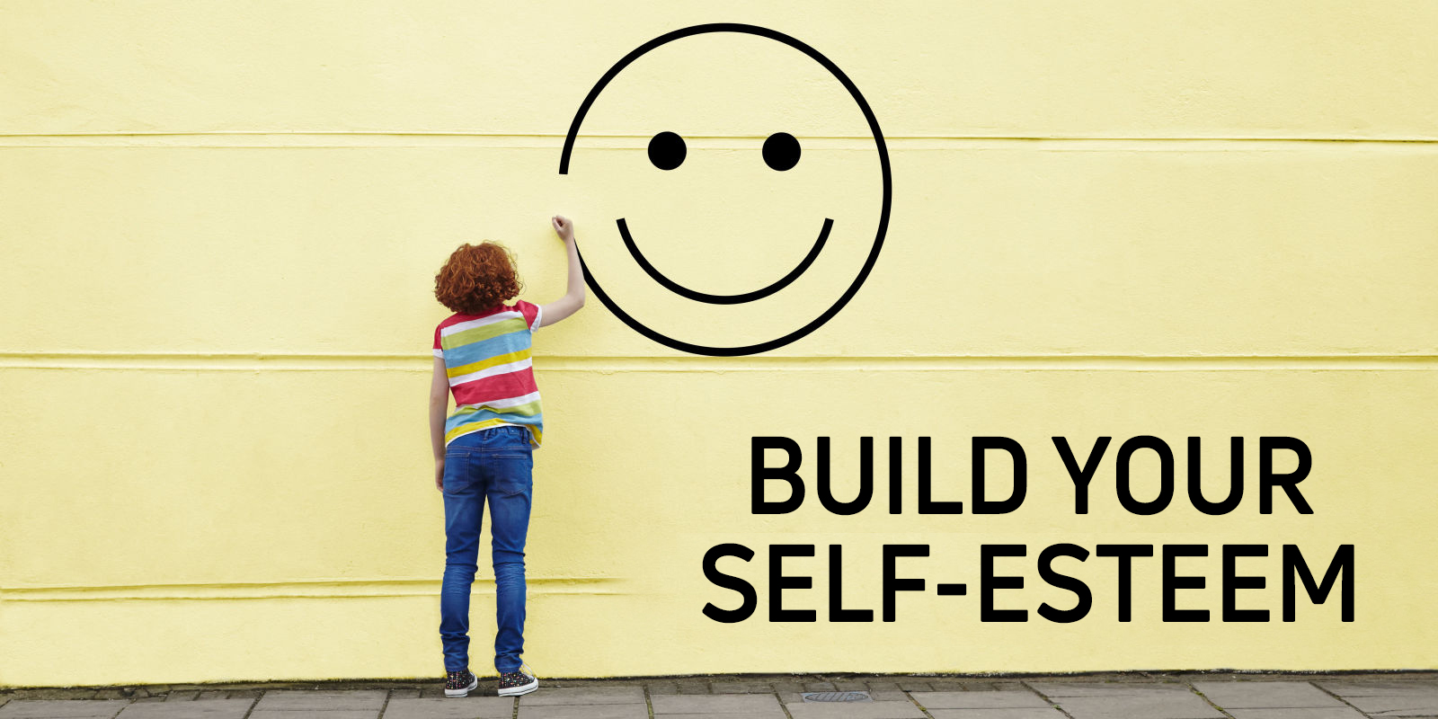
03
Knowing my value is the basis of harmony
https://www.youtube.com/watch?v=uOrzmFUJtrs

Slide 7
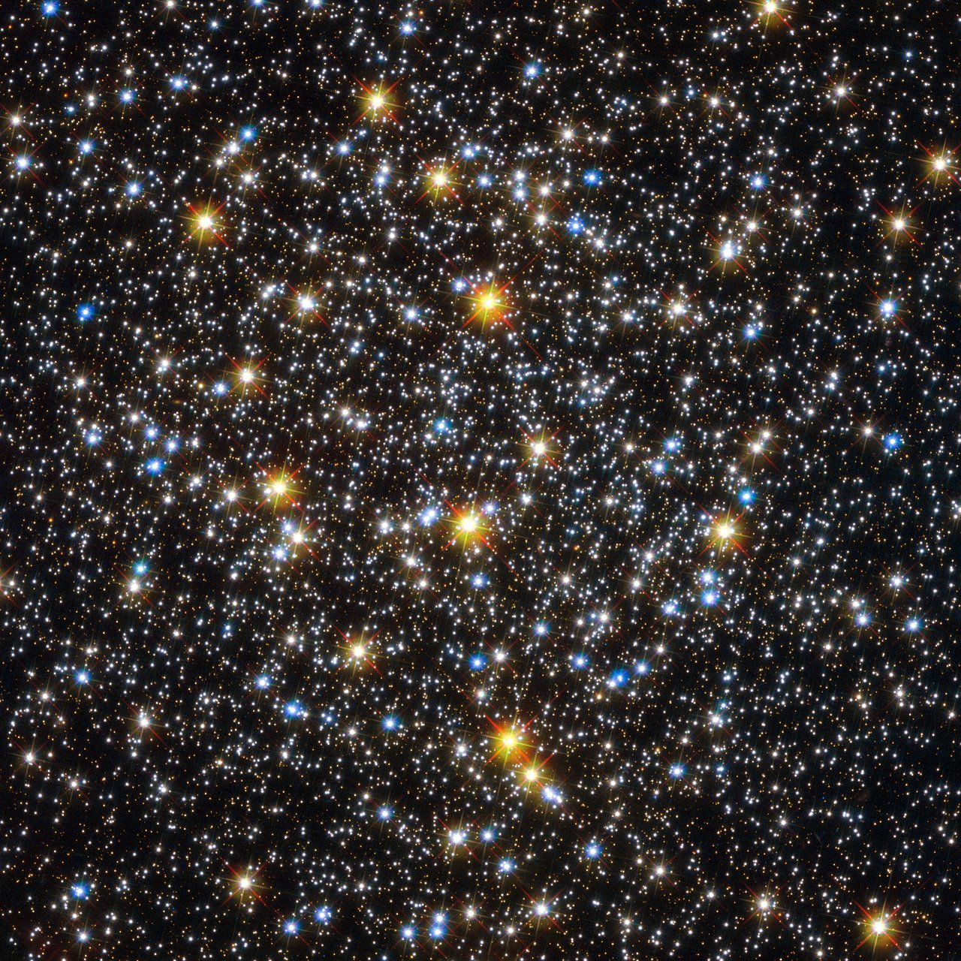
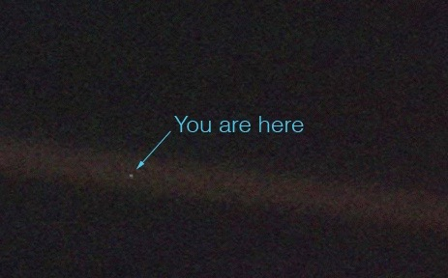
04
Chance of being born as me and my value
Earth Photograph taken from Voyager
(Pale Blue Dot)

Slide 8
Exploration 2
My Influence

Slide 9
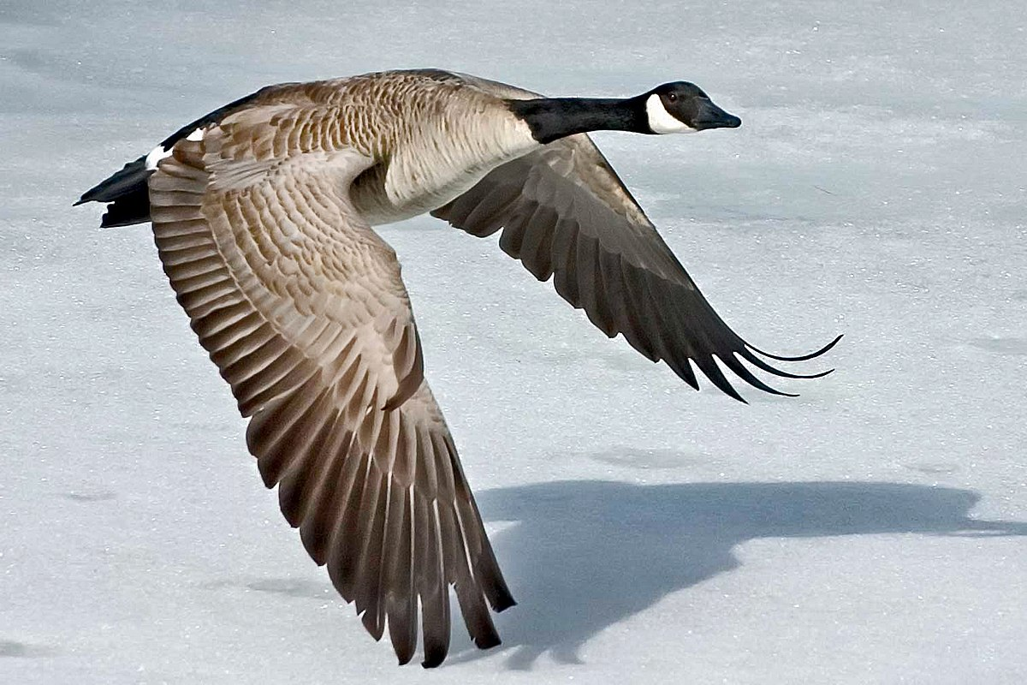
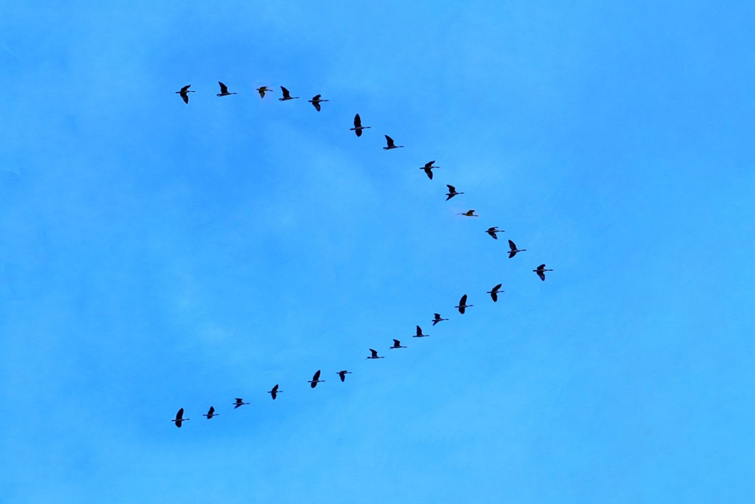
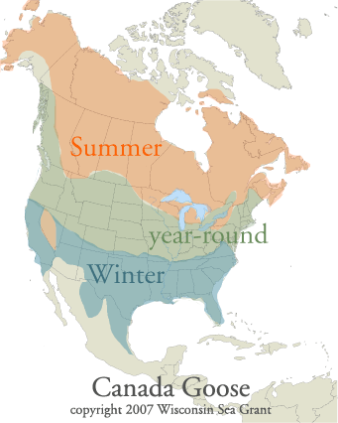
01
Migratory birds flying a long distance helping each other
https://www.youtube.com/watch?v=5QAjfH05IUE
If you want to go fast, go alone.
If you want to go far, go together.
- African proverb -

Slide 10
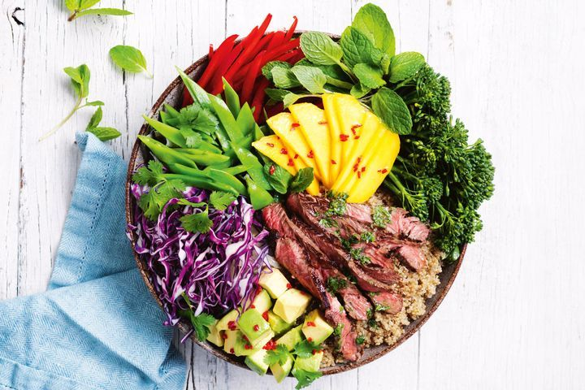
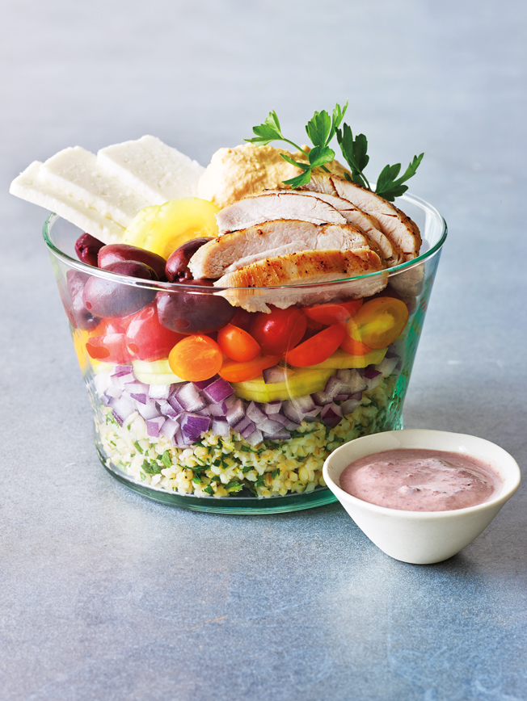
02
Salad Bowl Theory that reveals each other’s value and influence
We can create a new culture when we are connected and blend as one with our own uniqueness.

Slide 11
Exploration 3
My Role and Duty

Slide 12
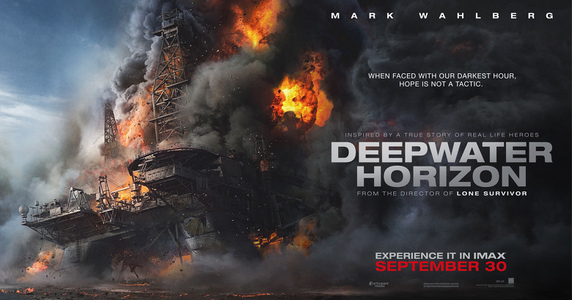
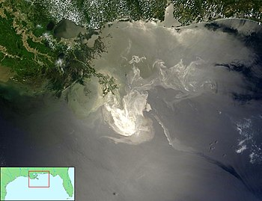
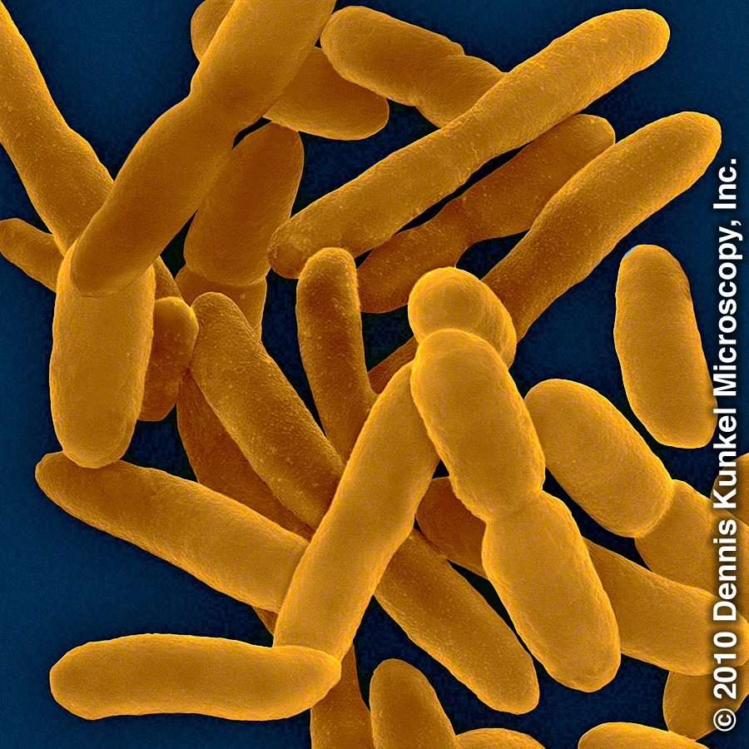
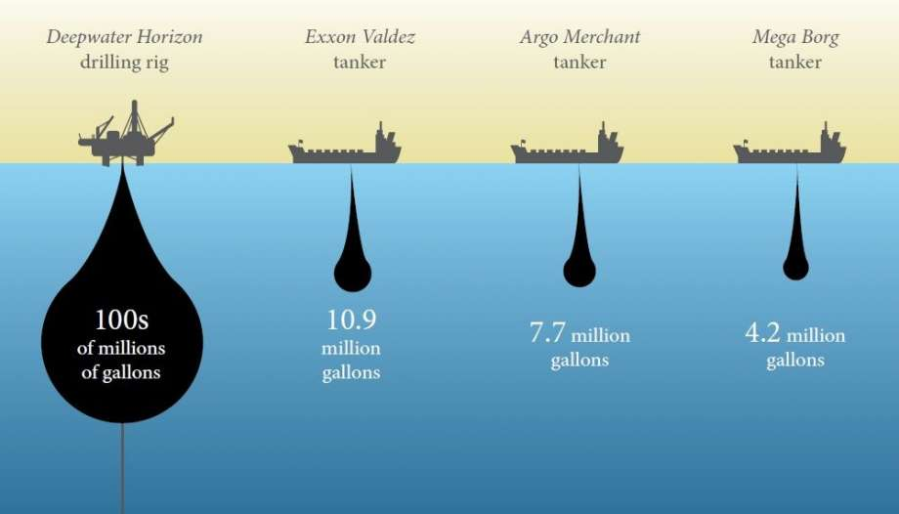
01
An oil spill in the Gulf of Mexico and bacteria that eat oil
Movie <Deepwater Horizon>
An oil spill in the Gulf of Mexico
Bacteria eating oil
the largest oil spill in history

Slide 13
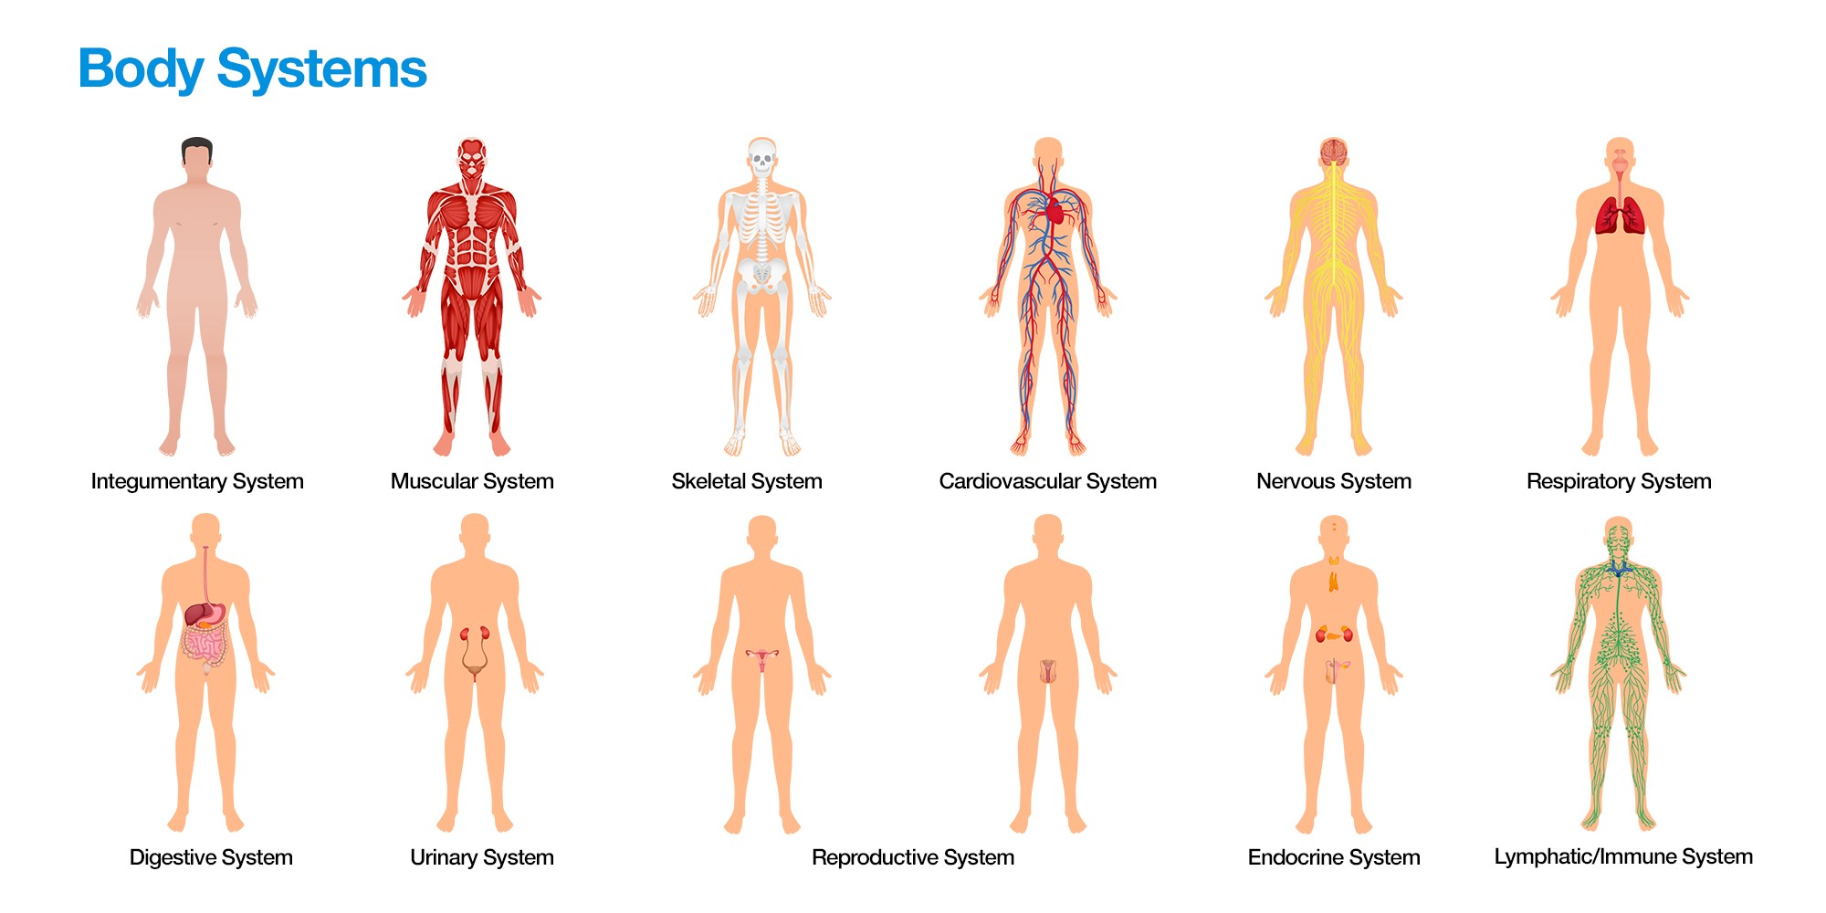
02
Structure of the human body playing each part’s role
https://www.youtube.com/watch?v=Ae4MadKPJC0
Wood-Wide-Web
뿌리에 붙어 있는 균들

Slide 14
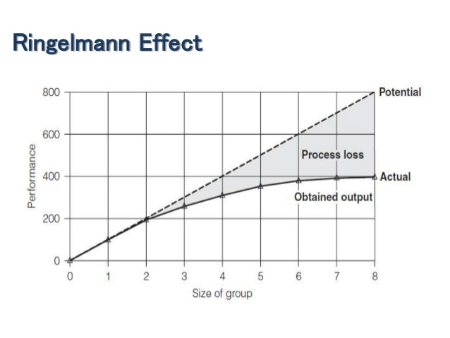
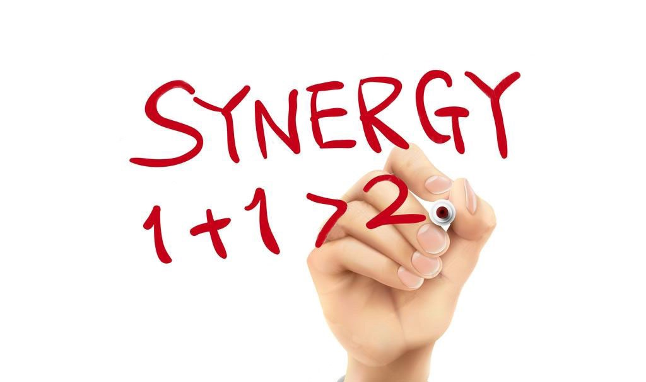
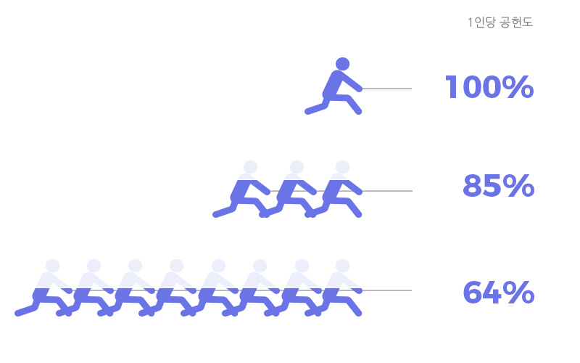
03
Comparison between the Synergistic effect and Ringelmann effect
vs

Slide 15
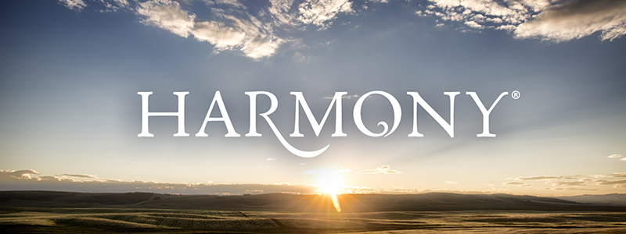
Conclusion
My Value (All creations have their own meaning and value)
My Influence (We know our influence and fill each other’s needs)
My Role and Duty
(All creations know their role and duty and perform them faithfully)

